Slide 1
The Curry-Howard Correspondence
Ruize Tang
2019/07/02

Slide 2

The Curry-Howard Correspondence*
What we did:
Define a programming language
Define a type system to rule out “bad” programs
What logicians do:
Define logic propositions
E.g. p, q ::= B | p ∧ q | p ∨ q | p ⇒ q
Define a proof system to prove “good” propositions
Turn out to be related
Propositions are Types
Proofs are Programs
------------
* Following Xinyu Feng's teaching materials.

Slide 3
The Curry-Howard Correspondence
Formulas of constructive propositional logic
(Prop) p, q ::= B | p ⇒ q | p ∧ q | p ∨ q
Types of STLC(The Simply Typed Lambda-Calculus) with products and sums
(Types) τ, σ ::= T | σ → τ | σ × τ | σ + τ

Slide 4
Coq's Mechanisms for Programming and Proving
Programming:
inductive data types like nat or list,
functions over these types.
Proving:
using inductive propositions (like even),
implication,
universal quantification, and the like.
We have mostly treated these mechanisms as if they were quite separate.
But Coq's programming and proving facilities are closely related.

Slide 5
Coq's Mechanisms for Programming and Proving
The keyword Inductive is used to declare
data types
propositions.
→ is used to describe
the type of functions on data,
logical implication.
Is this just a syntactic accident?
No! In fact, programs and proofs in Coq are almost the same thing.

Slide 6
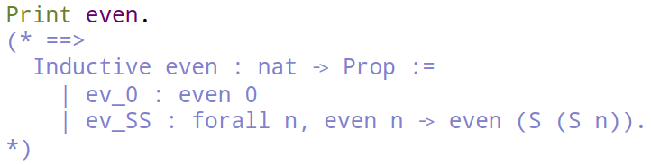
Proofs are Programs that Manipulate Evidence
Provability in Coq is represented by concrete evidence.
Proof of A → B will be an evidence transformer: a recipe for converting evidence for A into evidence for B.
Question: If evidence is data, what are propositions themselves?
Answer: They are types!
has type
is a proof of

Slide 7
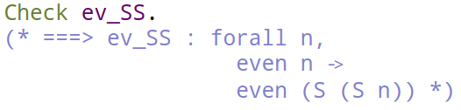



Proofs are Programs that Manipulate Evidence
This can be read "ev_SS is a constructor that takes two arguments — a number n and evidence for the proposition even n — and yields evidence for the proposition even (S (S n))."

Slide 8
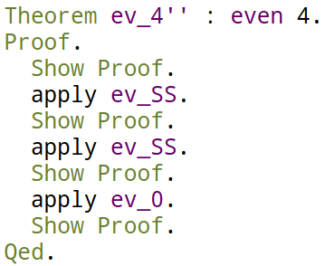
Proof Scripts and Proof Objects
A proof object -- a term whose type is the proposition being proved.
Following a proof script => (internally) constructing a proof object.
The tactics between Proof and Qed tell it how to build up a term of the required type.
Show Proof command displays the current state of the proof tree.

Slide 9

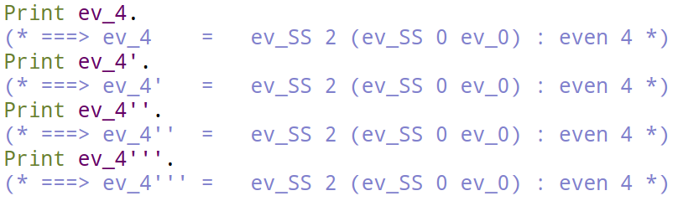
Proof Scripts and Proof Objects
Tactic proofs are not essential.
In principle, we can always construct the required evidence by hand.

Slide 10
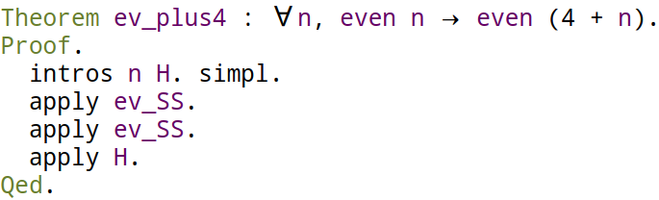


Quantifiers, Implications, Functions
What is the proof object corresponding to ev_plus4?
(We can simply Print ev_plus4)

Slide 11



Quantifiers, Implications, Functions
E is not used. Using dummy identifier _.
Or, equivalently,
In general, "P → Q" is just syntactic sugar for "∀ (_:P), Q".

Slide 12
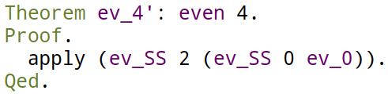

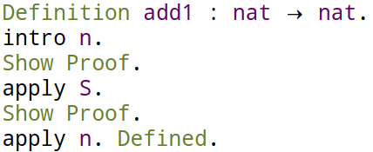
Programming with Tactics
Proof using tactics.
Function using terms.
Function using tactics.

Slide 13
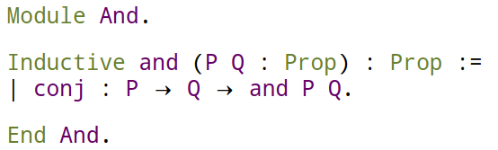
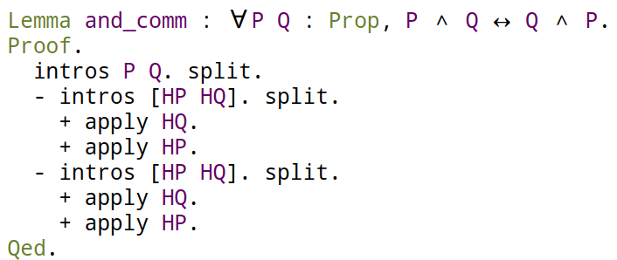
Logical Connectives as Inductive Types
Inductive definitions are powerful enough.
Only universal quantification (with implication as a special case) is built into Coq; all the others are defined inductively.

Slide 14
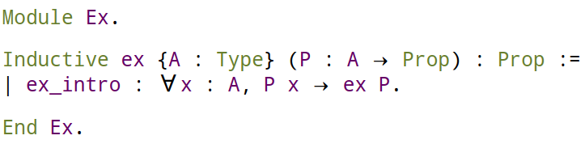

Logical Connectives as Inductive Types
Existential Quantification:
True and False:

Slide 15



Equality
Even equality relation is not built in.
Leibniz equality: "x and y are equal" is that every property on P that is true of x is also true of y.
Prove coq equality implies Leibniz equality.

Slide 16
Thank You!

